Slide 1
Class 9: Spatio-temporal transformers for sparse environmental data

Slide 2
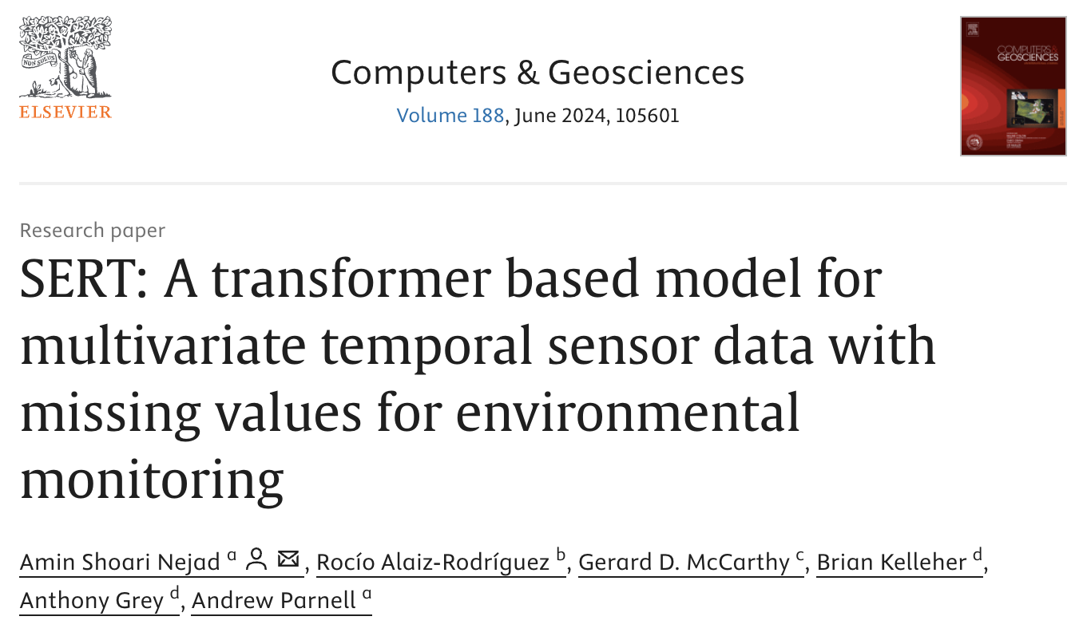
Outline
Summarising this paper
A holy grail of current weather forecasting: direct observation prediction
The SERT method is one potential way of achieving this

Slide 3
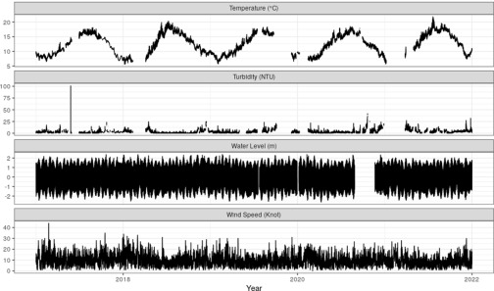
Sparse and misaligned data

Slide 4
Why is it sparse and misaligned?
Multivariate misalignment: sensors fail independently (e.g. pH still working while turbidity is down)
Asynchronous arrival: time stamps of sensors not perfectly calibrated
Block missingness: biofouling or battery death cause longer gaps
Even worse: variables of interest cause the missingness to occur leading to potential prediction bias

Slide 5
Why not just impute?
Lots of methods to fill in missing data (AKA imputation)
Very simple versions (e.g. mean imputation)
Multiple Imputation
ML-based imputation (e.g. missForest)
Model-based imputation
But: these all introduce ‘fake’ data and take up extra time

Slide 6
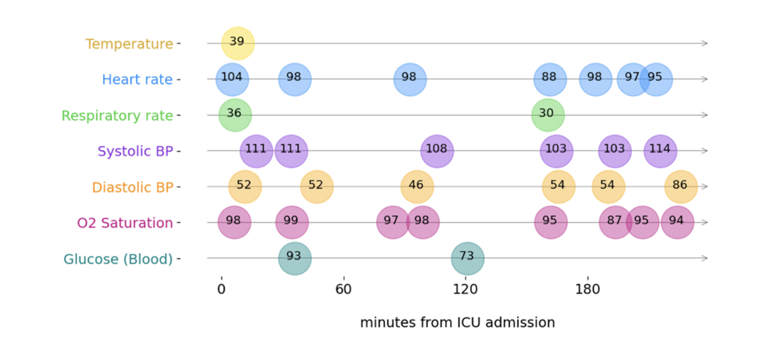
The key idea
From Tipirneni and Reddy (2022), ACM Trans. Knowl. Discov. Data

Slide 7
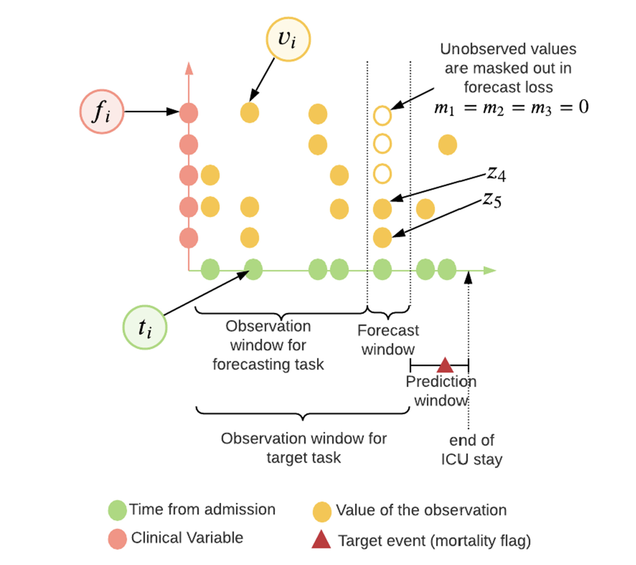
The key idea (part 2)
From Tipirneni and Reddy (2022), ACM Trans. Knowl. Discov. Data

Slide 8
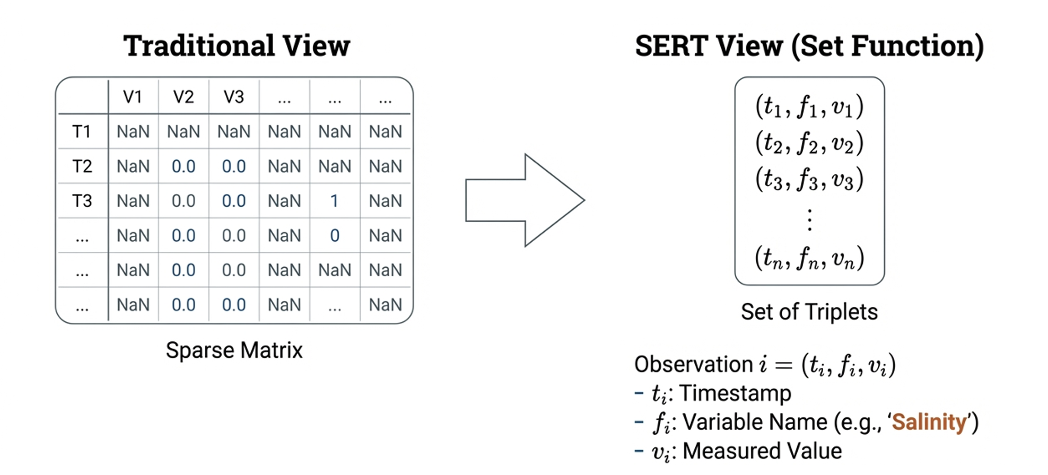
From grids to sets

Slide 9
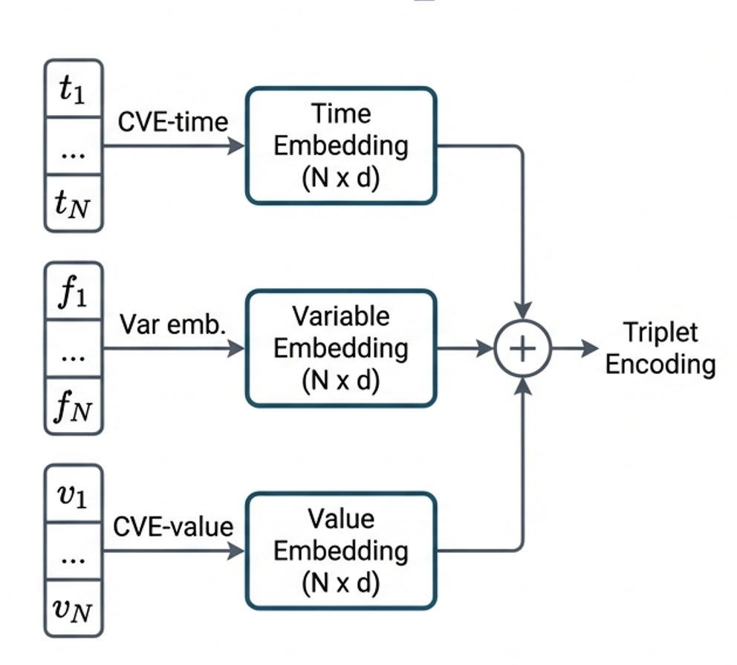
Encodings
Each of the variables, time stamps, and values get embedded individually
Then all the embedding values get added together
(Should do some pre-training to get the best values of these)

Slide 10
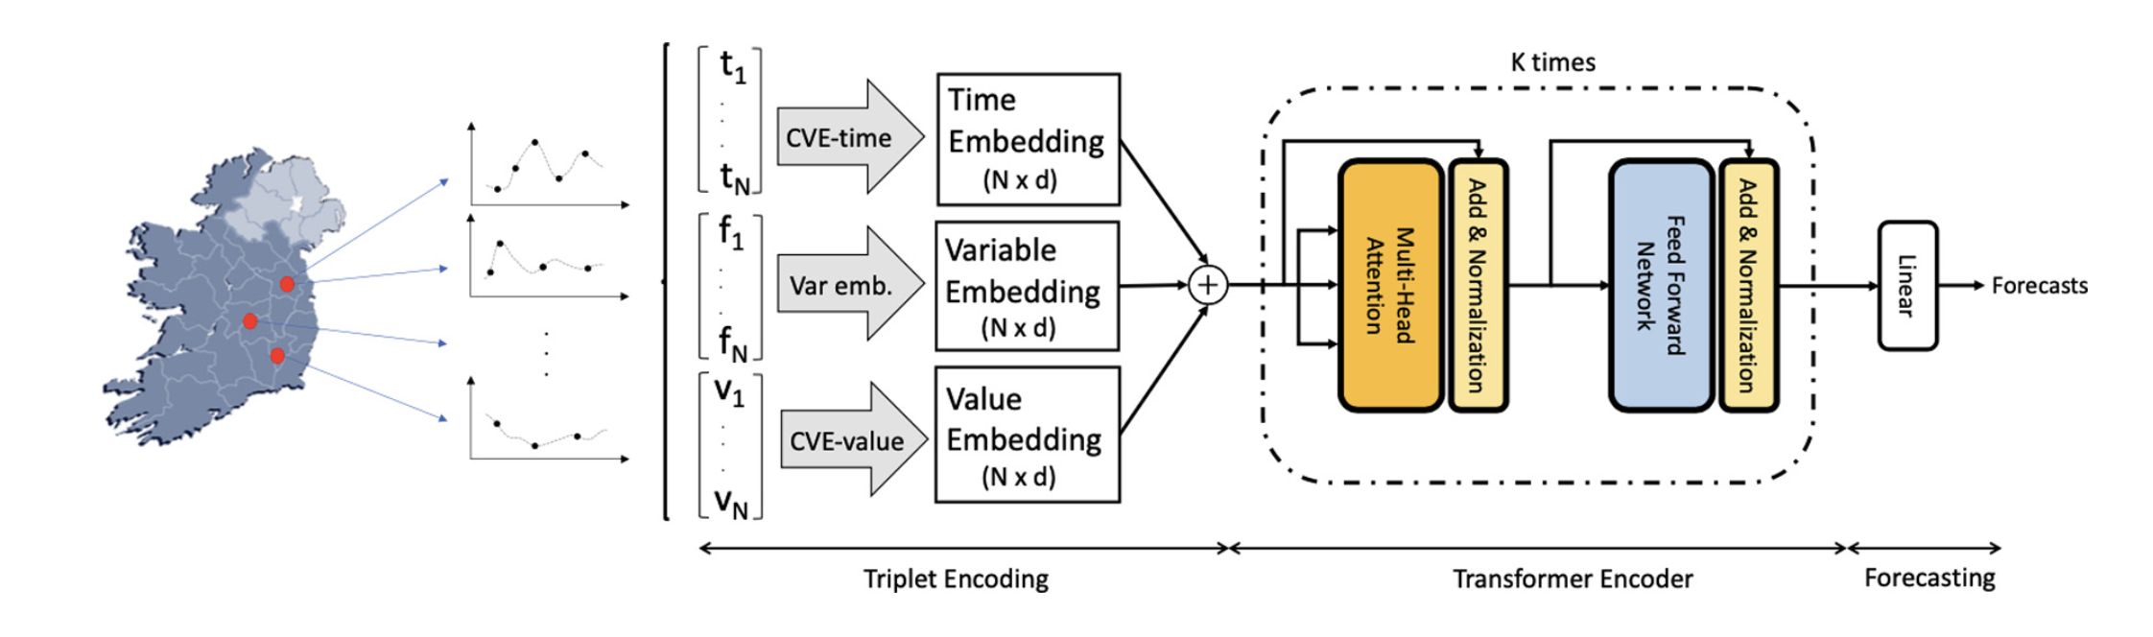
The overall model
Where to put location?
Could add a 4th embedding
Or add later into the linear layer

Slide 11
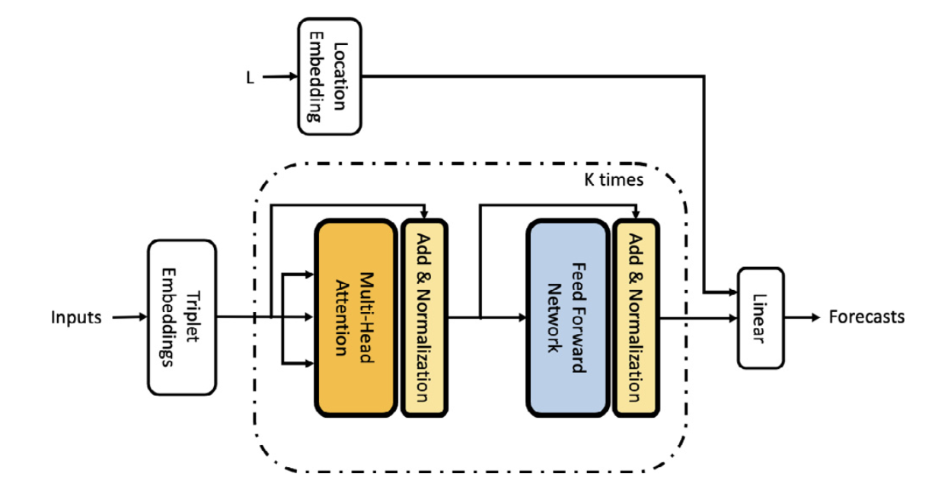
Adding in location in the linear layer

Slide 12
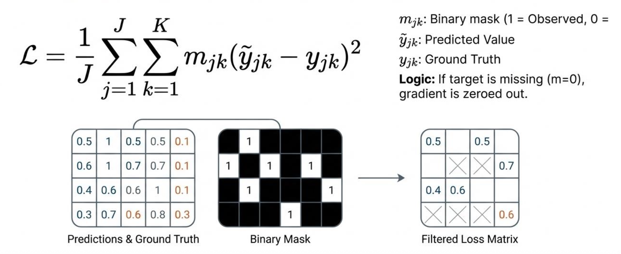
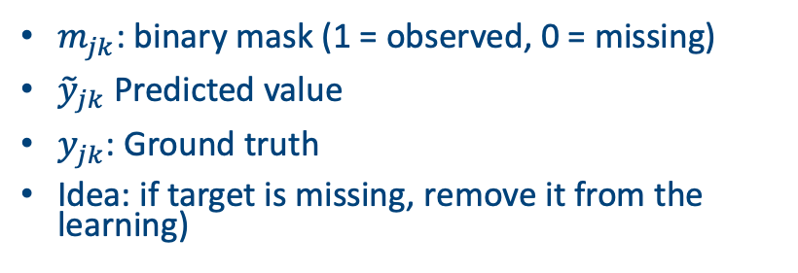
Training strategy: masked loss
$m_{jk}$: binary mask (1 = observed, 0 = missing)
${\tilde{y}}_{jk}$ Predicted value
$y_{jk}$: Ground truth
Idea: if target is missing, remove it from the learning)

Slide 13
Pre-training
Can obtain superior performance by pre-training the individual components (time, feature, location, value)
For example, for the feature vector:
If two variables (e.g., wind speed and wave height) frequently appear together in the same measurement ‘packets’ they should have related embeddings
Give each feature a number (1 = salinity, 2 = temperature, etc)
Either use an existing embedding data set (e.g. word2vec)
Or use the existing data set and set up a model that takes pairs of variable names and an output as to whether they co-occur or not
One of the hidden layers in the model can then determine the embedding values (and you can choose the dimension of these)

Slide 14
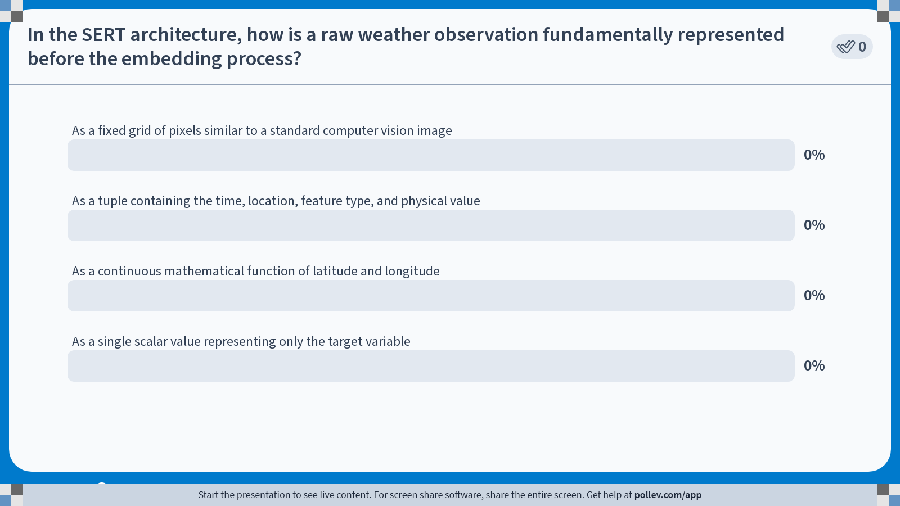
Notes:
Do not modify the notes in this section to avoid tampering with the Poll Everywhere activity. More info at polleverywhere.com/support In the SERT architecture, how is a raw weather observation fundamentally represented before the embedding process?
https://www.polleverywhere.com/multiple_choice_polls/JdsPEwhx0fnjgqyktqp36?state=opened&flow=Default&onscreen=persist

Slide 15
SERT by hand
Go through an example on the board

Slide 16
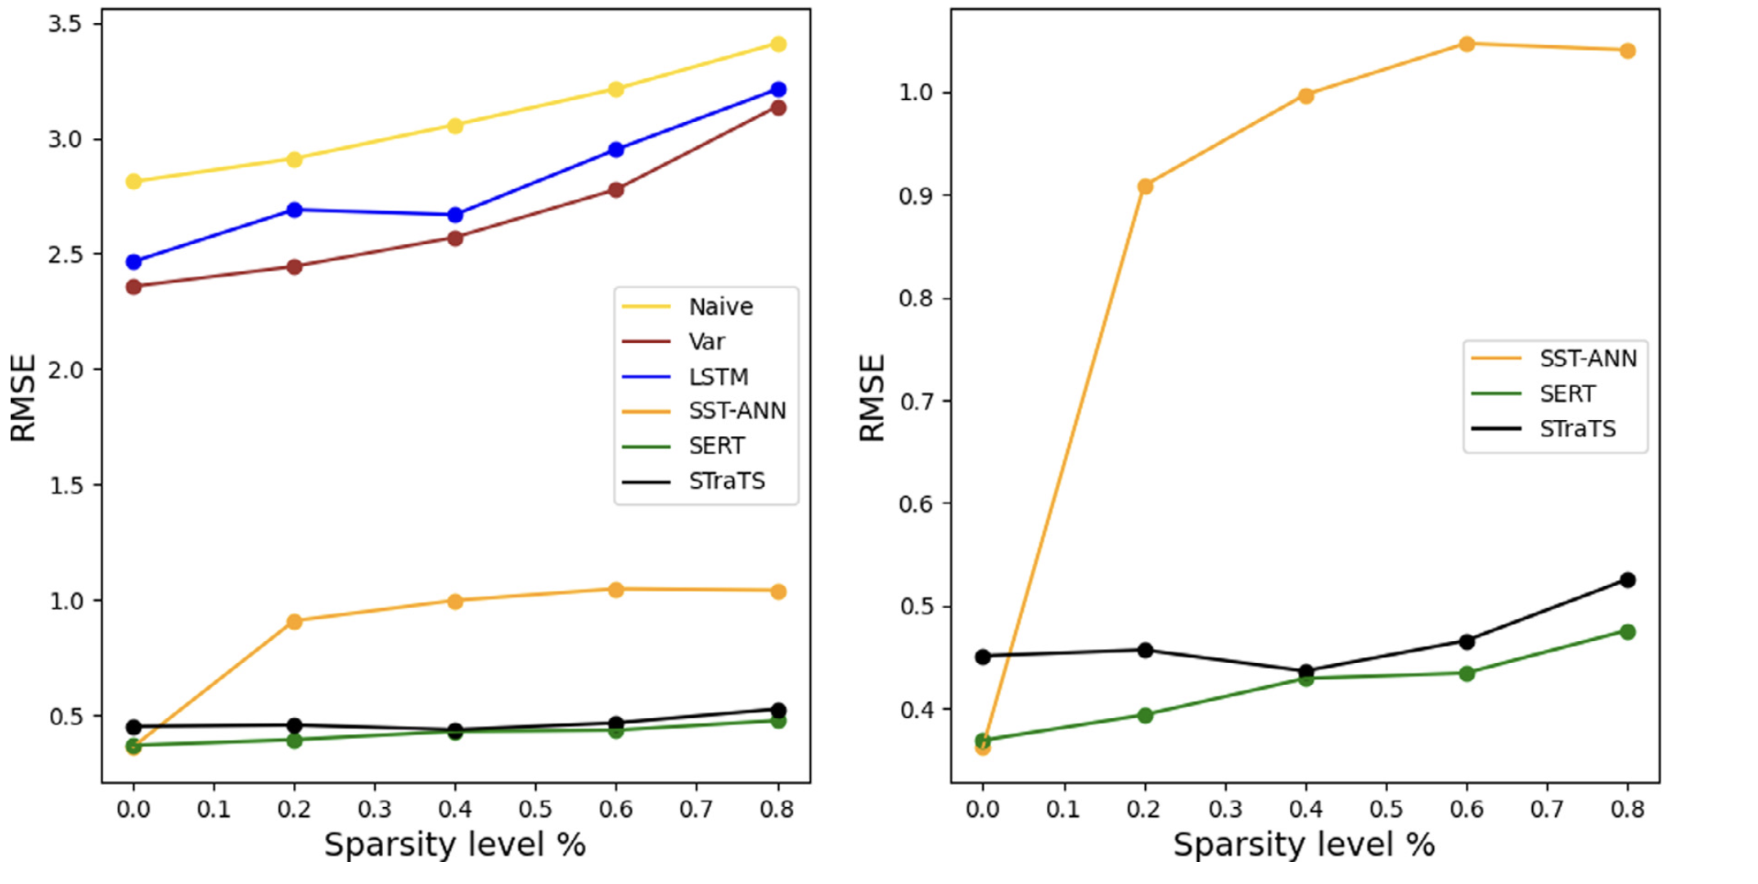
Synthetic data performance

Slide 17
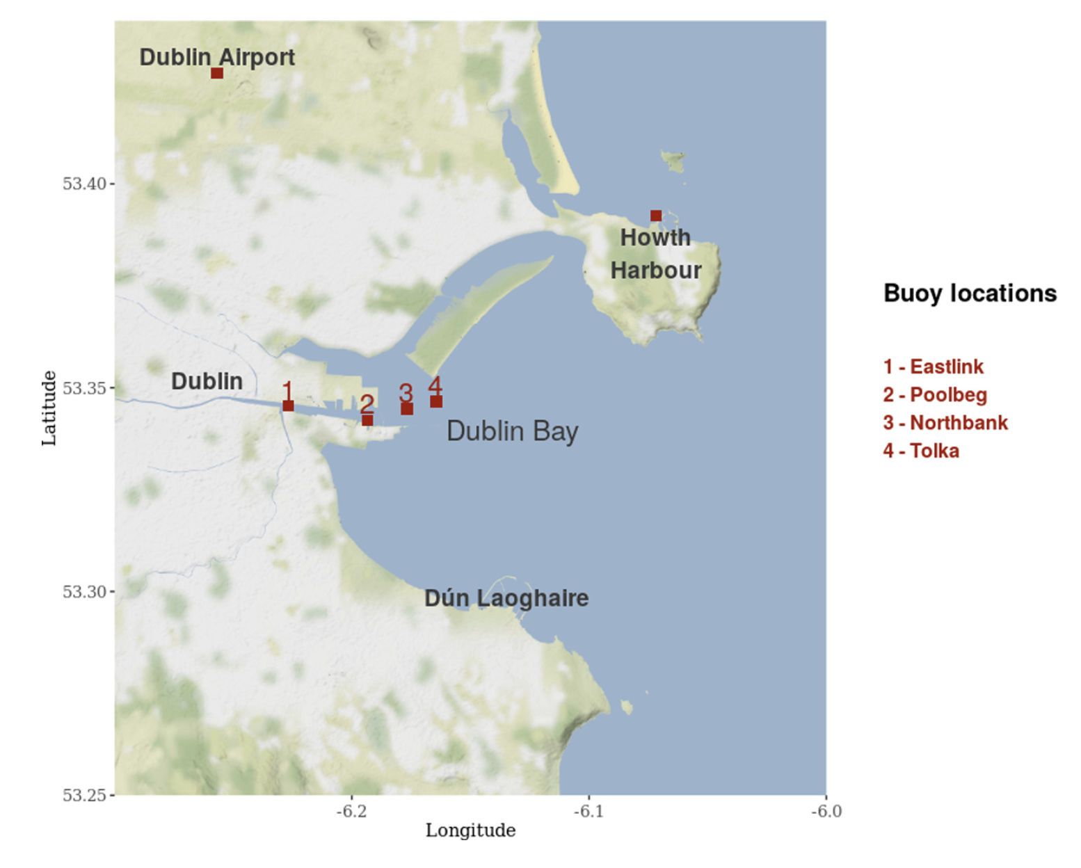
Real data

Slide 18
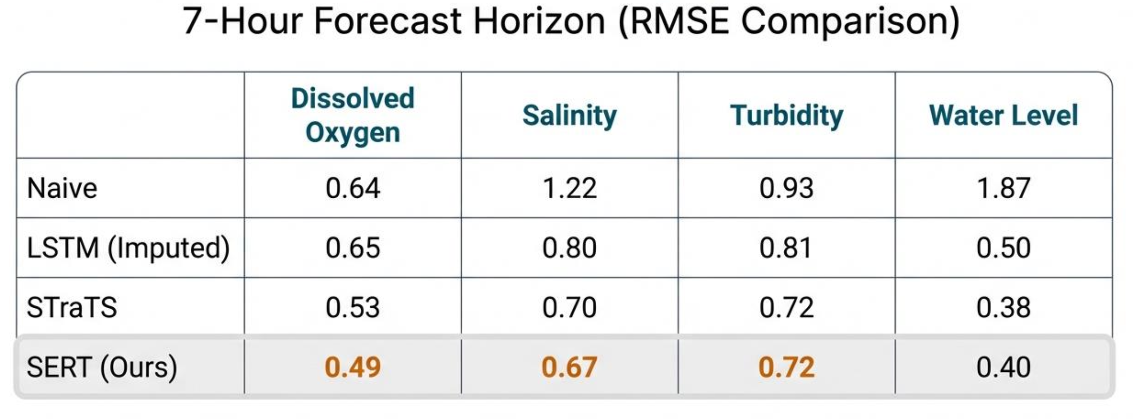
Real data performance
Naïve = persistence forecast

Slide 19
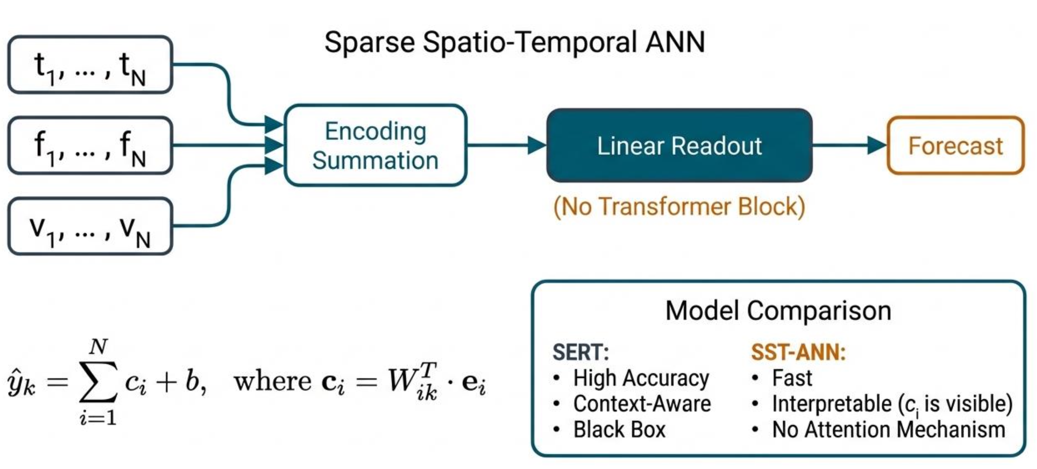
A ‘light’ version of the model – SST-ANN
Version with transformer is too complicated to enable easy interpretation
Skip that part out and replace with a simple ANN

Slide 20
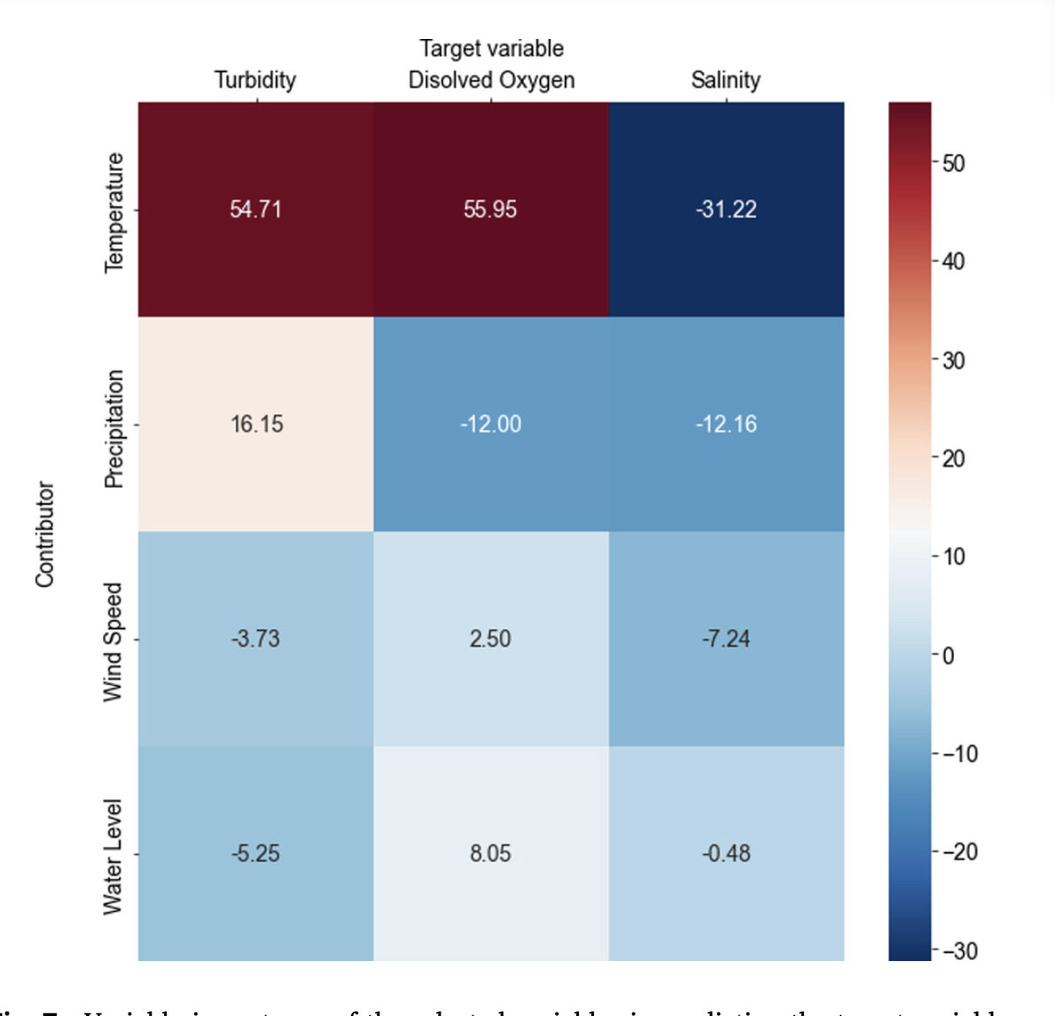
Intepretability
Can now look at opening the black box
The average contribution score 𝑐 gives importance of the predictor variable to the prediction of the target variable.
Temperature followed by precipitation are the most important variables in predicting the target variables

Slide 21
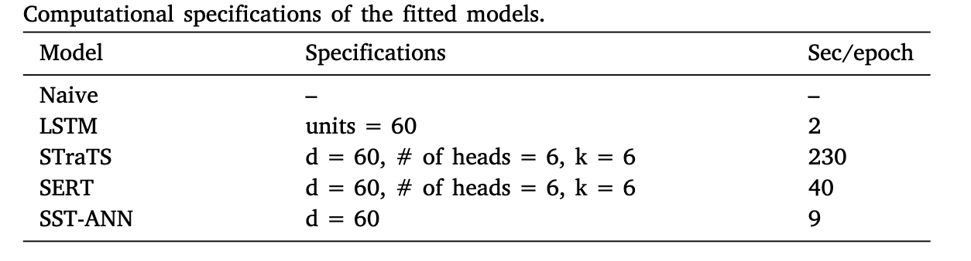
Computation

Slide 22
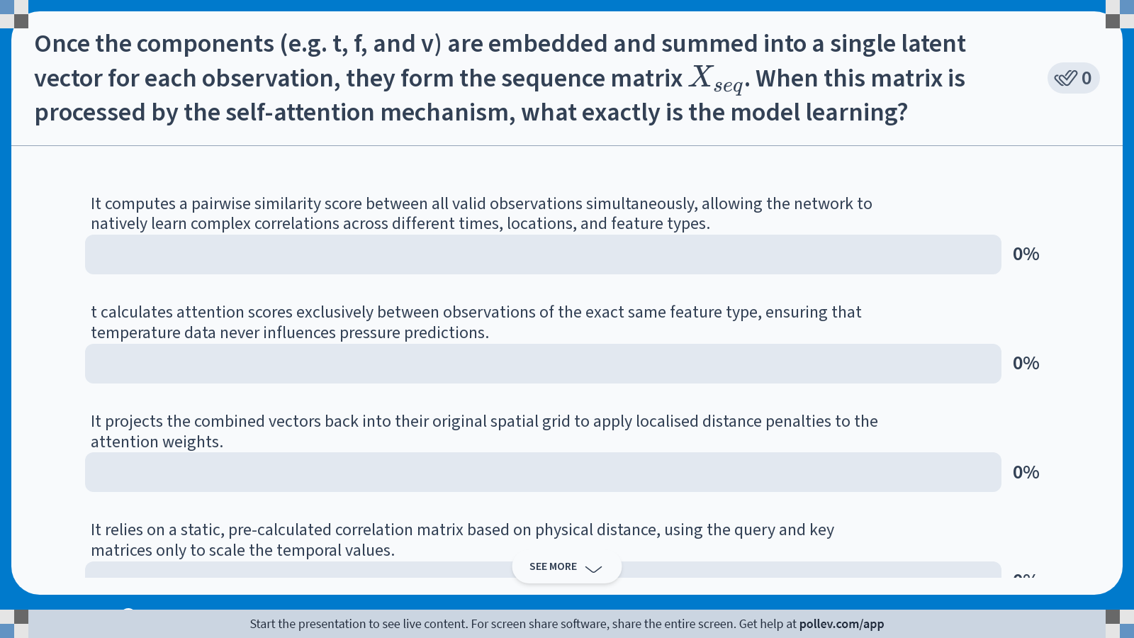
Notes:
Do not modify the notes in this section to avoid tampering with the Poll Everywhere activity. More info at polleverywhere.com/support Once the components (e.g. t, f, and v) are embedded and summed into a single latent vector for each observation, they form the sequence matrix $$X_{seq}$$. When this matrix is processed by the self-attention mechanism, what exactly is the model learning?
https://www.polleverywhere.com/multiple_choice_polls/Zk8lBVm5EnEXxM7yXpRHw?state=opened&flow=Default&onscreen=persist

Slide 23
Summary
SERT is a potential way to get to direct observation prediction for weather/environmental/climate data
It fundamentally changes the way we treat the data, instead seeing is as triples or quadruples representing time, space, feature and value
The transformer architecture (or any architecture) can be used on the embedded quantities to produce predictions for a given forecast horizon

Slide 24
Relevant code
Super_simple_probabilistic_ANN.ipynb
Irish_ERA5_Probabilistic_Forecasting.ipynb
https://github.com/Aminsn/SERT2023
https://github.com/Aminsn/sert

Slide 25
Afternoon session instructions
Either
Go and install the SERT package and run some of the example scripts, or
Run some of the probabilistic forecasting routines and check you understand how they work
Find some (new) data and run it through your chosen model
Present your file in 5 minutes

